Slide 1




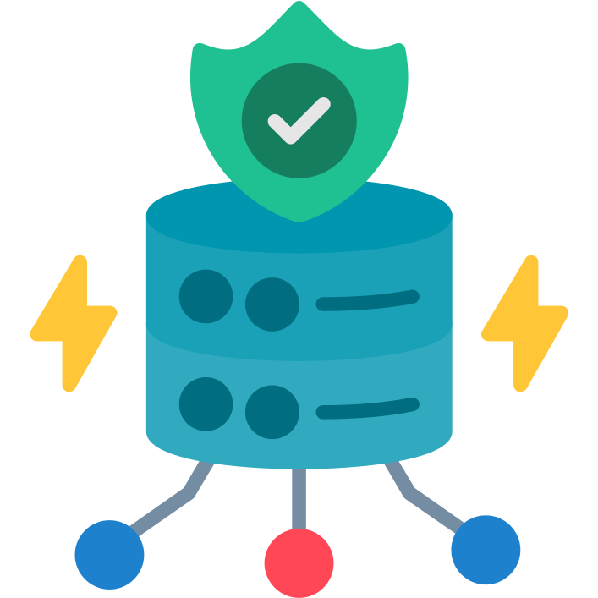



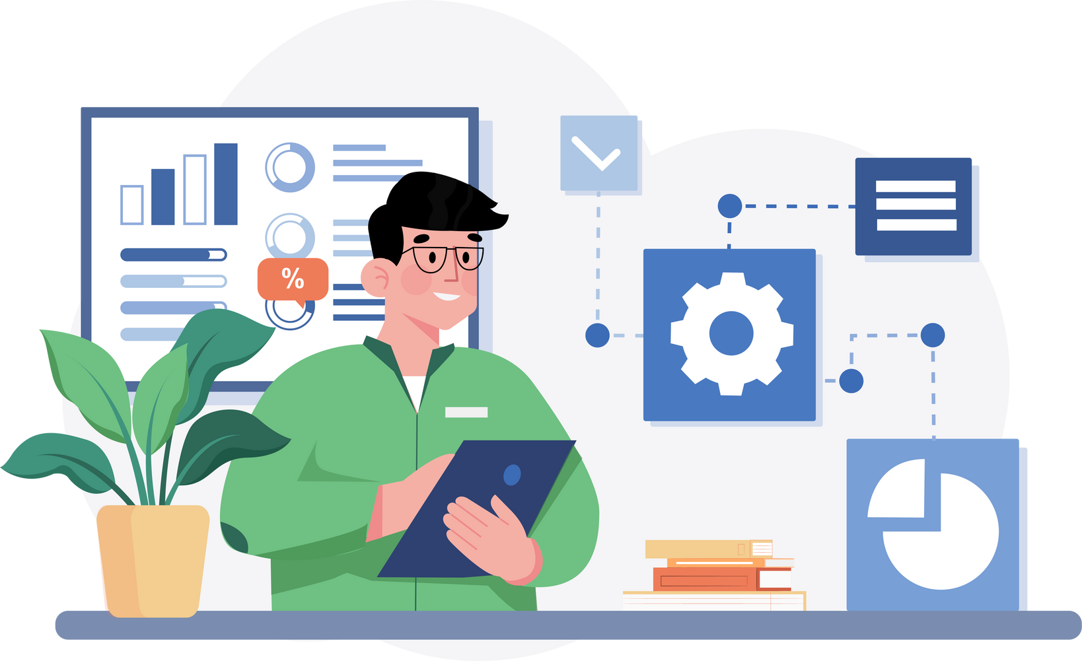
Step 2: Access Control
1
Nginx Router
Oauth2 Proxy
Authorization Proxy
2
3
TAASe

Slide 2






Data Sync
Scan
Sense & QRG Data Source
Airflow Scheduler
QuantEdge & SQLi Data Source
Trails Data Source
Sync
Quant Discovery Data Source

